Slide 1
PROJECT MANAGEMENT LESSONS LEARNED
CE 4200 PROFESSIONAL ENGINEERING PRACTICE ISSUES
Spring 2022 SEMESTER
WILLIAM D. LAWSON, PE, PHD

Slide 2
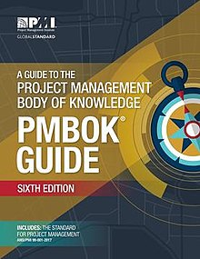
What is Project Management?
Project Management is the application of skills, knowledge, tools and techniques to meet the needs and expectations of stakeholders for a project.
The purpose of project management is prediction and prevention, NOT recognition and reaction

Slide 3

Project Success
Customer Requirements satisfied/exceeded
Completed within allocated time frame
Completed within allocated budget
Accepted by the customer

Slide 4

Project Failure
Scope Creep
Poor Requirements Gathering
Unrealistic planning and scheduling
Lack of resources

Slide 5
Triple Contraint
Time
Quality
Cost
Scope

Slide 6
Role of a Project Manager
Project issues
Disseminating project information
Mitigating project risk
Quality
Managing scope
Metrics
Managing the overall work plan
Implementing standard processes
Establishing leadership skills
Setting expectations
Team building
Communicator skills
Process Responsibilities
People Responsibilities
Notes:
Process Responsibilities
The project manager normally is responsible for defining and planning the project. This results in the completion of a Project Definition and a project workplan. Once the project starts, the project manager must successfully manage and control the work, including:
Identifying, tracking managing and resolving project issues
Proactively disseminating project information to all stakeholders
Identifying, managing and mitigating project risk
Ensuring that the solution is of acceptable quality
Proactively managing scope to ensure that only what was agreed to is delivered, unless changes are approved through scope management
Defining and collecting metrics to give a sense for how the project is progressing and whether the deliverables produced are acceptable
Managing the overall workplan to ensure work is assigned and completed on time and within budget
To manage the project management processes, a person should be well organized, have great follow-up skills, be process oriented, be able to multi-task, have a logical thought process, be able to determine root causes, have good analytical ability, be a good estimator and budget manager, and have good self-discipline.
People Responsibilities
In addition to process skills, a project manager must have good people management skills. This includes:
Having the discipline and general management skills to make sure that people follow the standard processes and procedures
Establishing leadership skills to get the team to willingly follow your direction. Leadership is about communicating a vision and getting the team to accept it and strive to get there with you.
Setting reasonable, challenging and clear expectations for people, and holding them accountable for meeting the expectations. This includes providing good performance feedback to team members
Team building skills so that the people work together well, and feel motivated to work hard for the sake of the project and their other team members. The larger your team and the longer the project, the more important it is to have good team-building skills.
Proactive verbal and written communicator skills, including good, active listening skills.
Multiple Roles
Depending on the size and complexity of the project, the project manager may take on other responsibilities in addition to managing the work. For instance, the project manager may assist with gathering business requirements. Or they may help design a database management system or they may write some of the project documentation. Project management is a particular role that a person fills, even if the person who is the project manager is working in other roles as well.

Slide 7
FAILURE #1. BUDGET
Client: Waste Management of North America
Year: 1995
Project: DFW Landfill, Northwest Sector
Location: Lewisville, TX

Slide 8
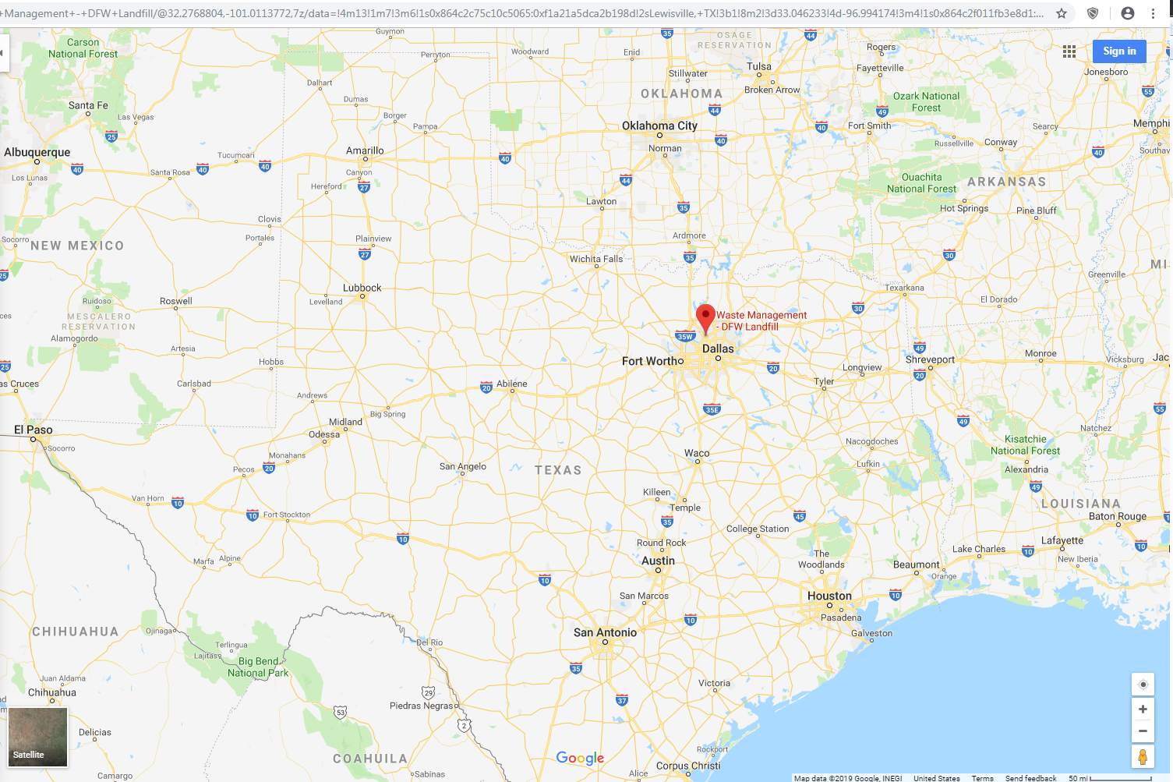
DFW LANDFILL, LEWISVILLE, TX

Slide 9
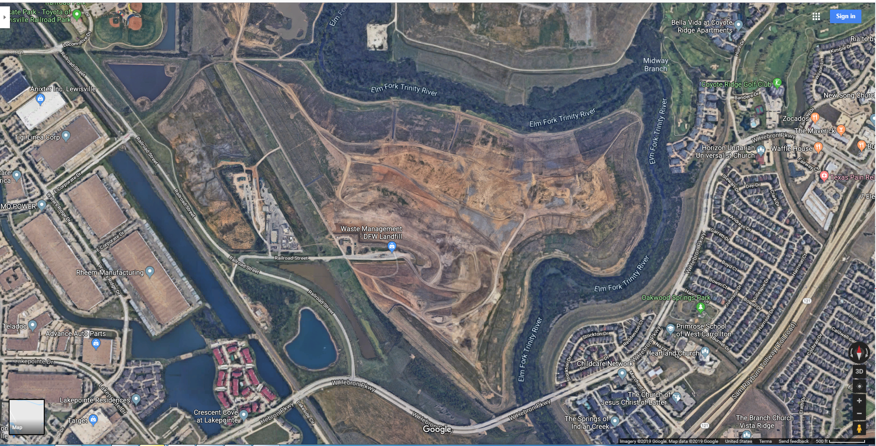
DFW LANDFILL, LEWISVILLE, TX

Slide 10
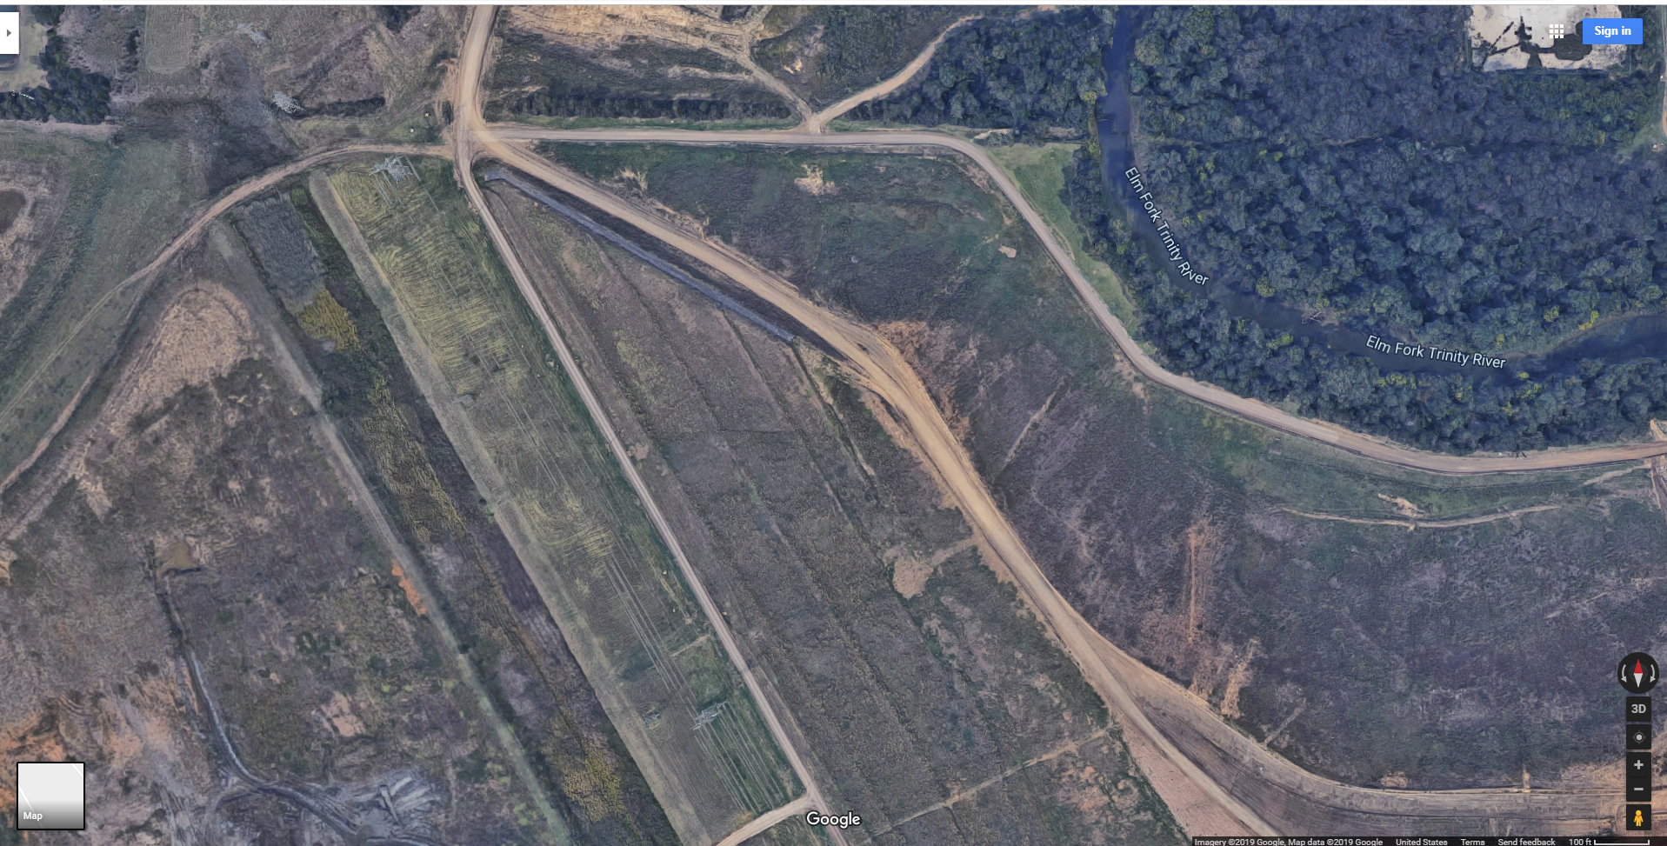
NORTHWEST SECTOR, DFW LANDFILL

Slide 11
BASIC PROJECT INFO
SIZE: 13 ACRES
DESIGN/CONSTRUCTION COST: $2.3MILLION
PROJECT DURATION: 45 DAYS
CQC/CQA CONTRACT: $135,000
+++++++
AS BUILT:
90+ DAYS
CQC/CQA CONTRACT: $250,000

Slide 12


Composite Liner System for Primary Leachate Collection
WASTE
2 ft protective cover
SECONDARY Liner
GT - geotextile
GN- geonet
PRIMARY LINER
3ft CLAY
Recompacted
in 6-in lifts
GM - geomembrane

Slide 13
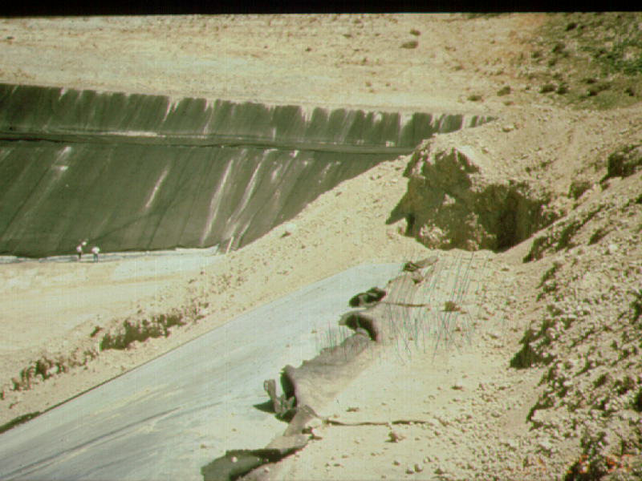

Slide 14
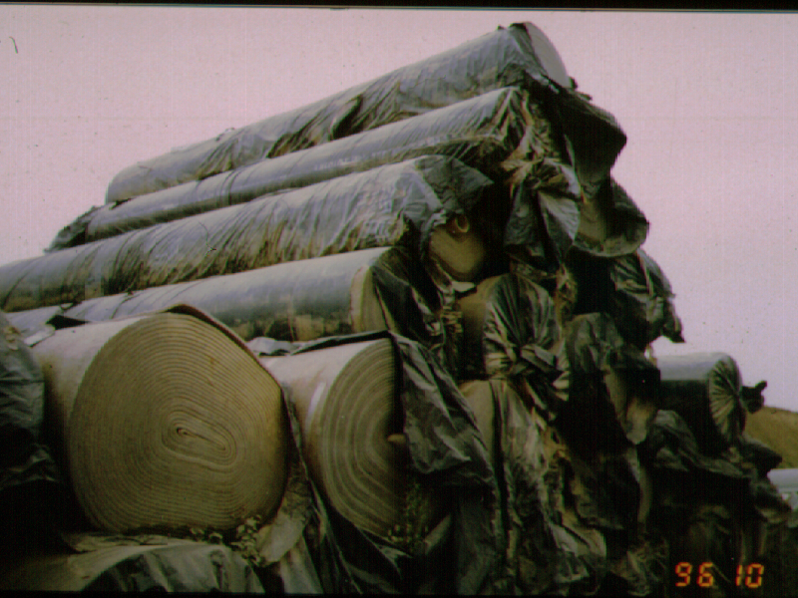

Slide 15
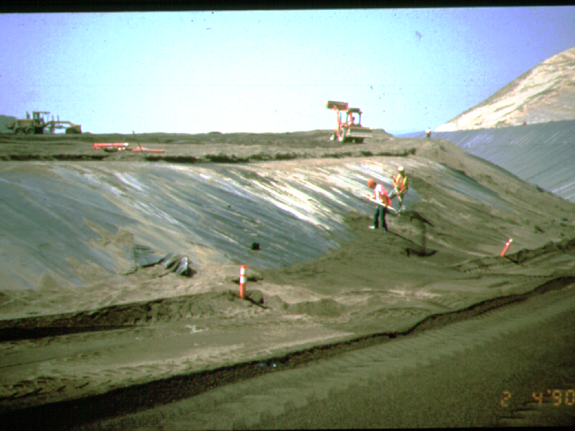

Slide 16
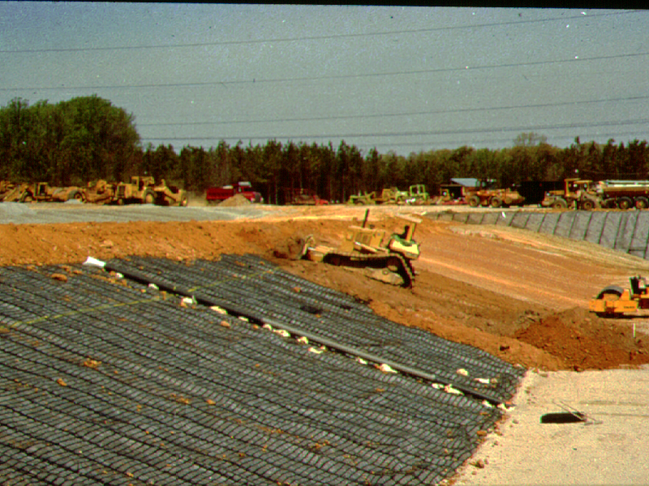

Slide 17
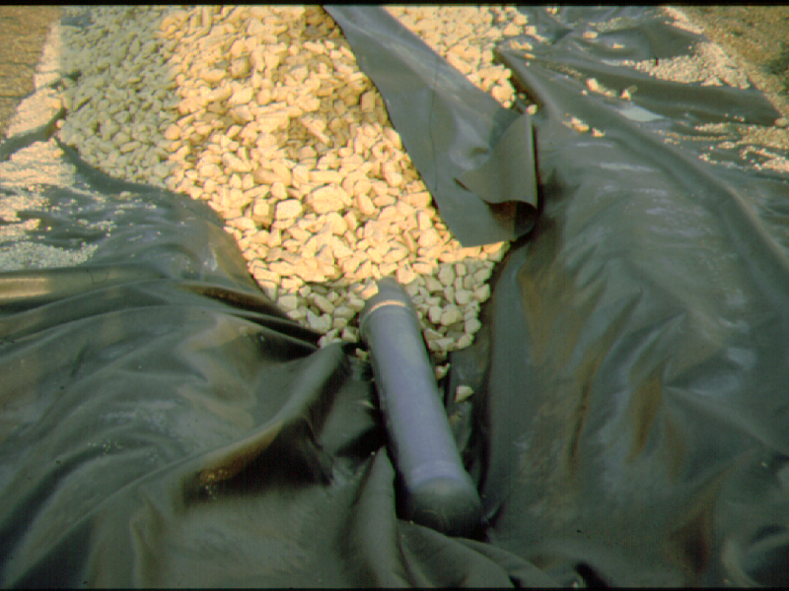

Slide 18
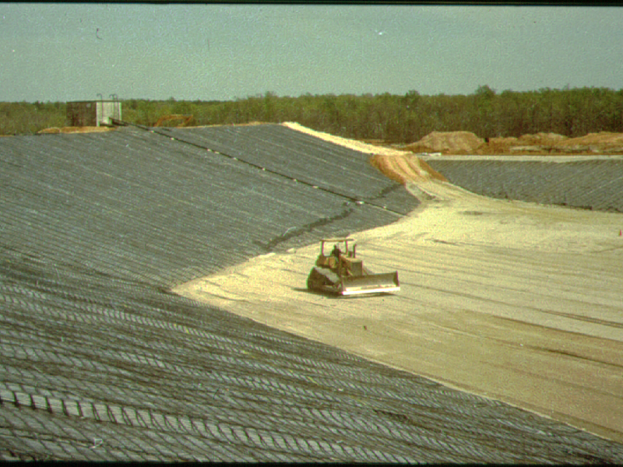

Slide 19
THE PROJECT MANAGEMENT PROBLEM
The situation
What do YOU think happened?
Here’s what happened

Slide 20
LESSONS LEARNED
“Hiding” is a natural, but counter-productive response to problems
Procrastinating does not help either
A project manager must know the status (budget, schedule) of his/her project at all times
Re-creating the project record, after the fact, is time-consuming, painful, and difficult
Project management failures like this cost big money
Clients are people too, with bosses, just like us, and they deserve answers
A solid client relationship can help overcome disaster
If a project doesn’t go well, do a “post mortem”

Slide 21
FAILURE #2. SCHEDULE
Client: Private Homeowner
Year: 2000
Project: Slope Stability Concern
Location: Waco, TX

Slide 22
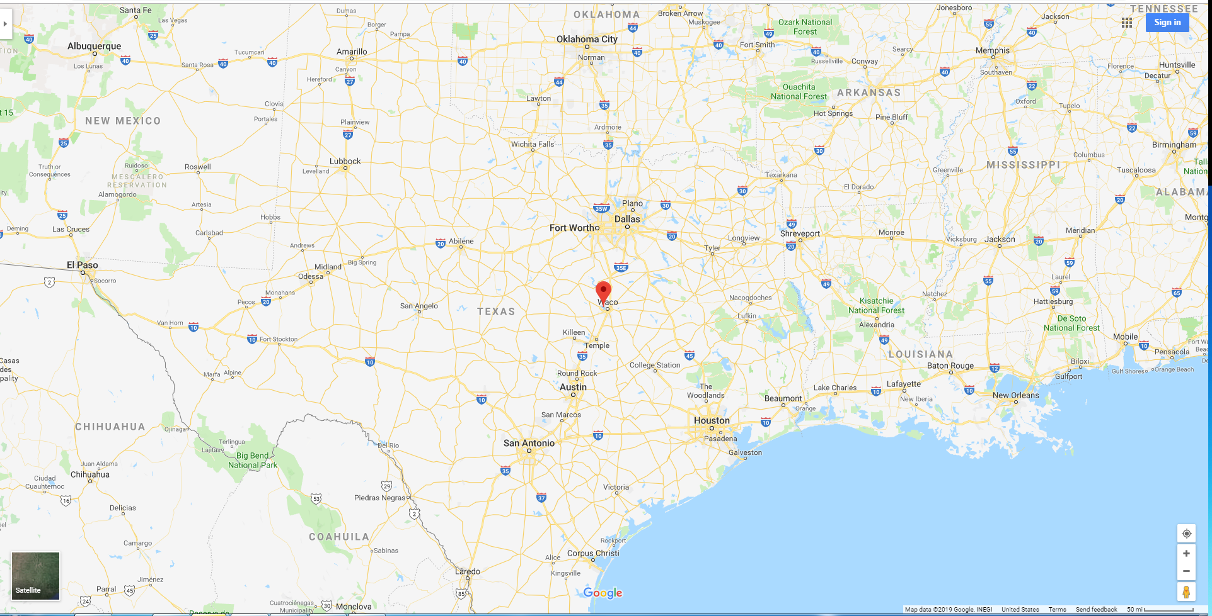
Private Residence, Lake Waco TX

Slide 23
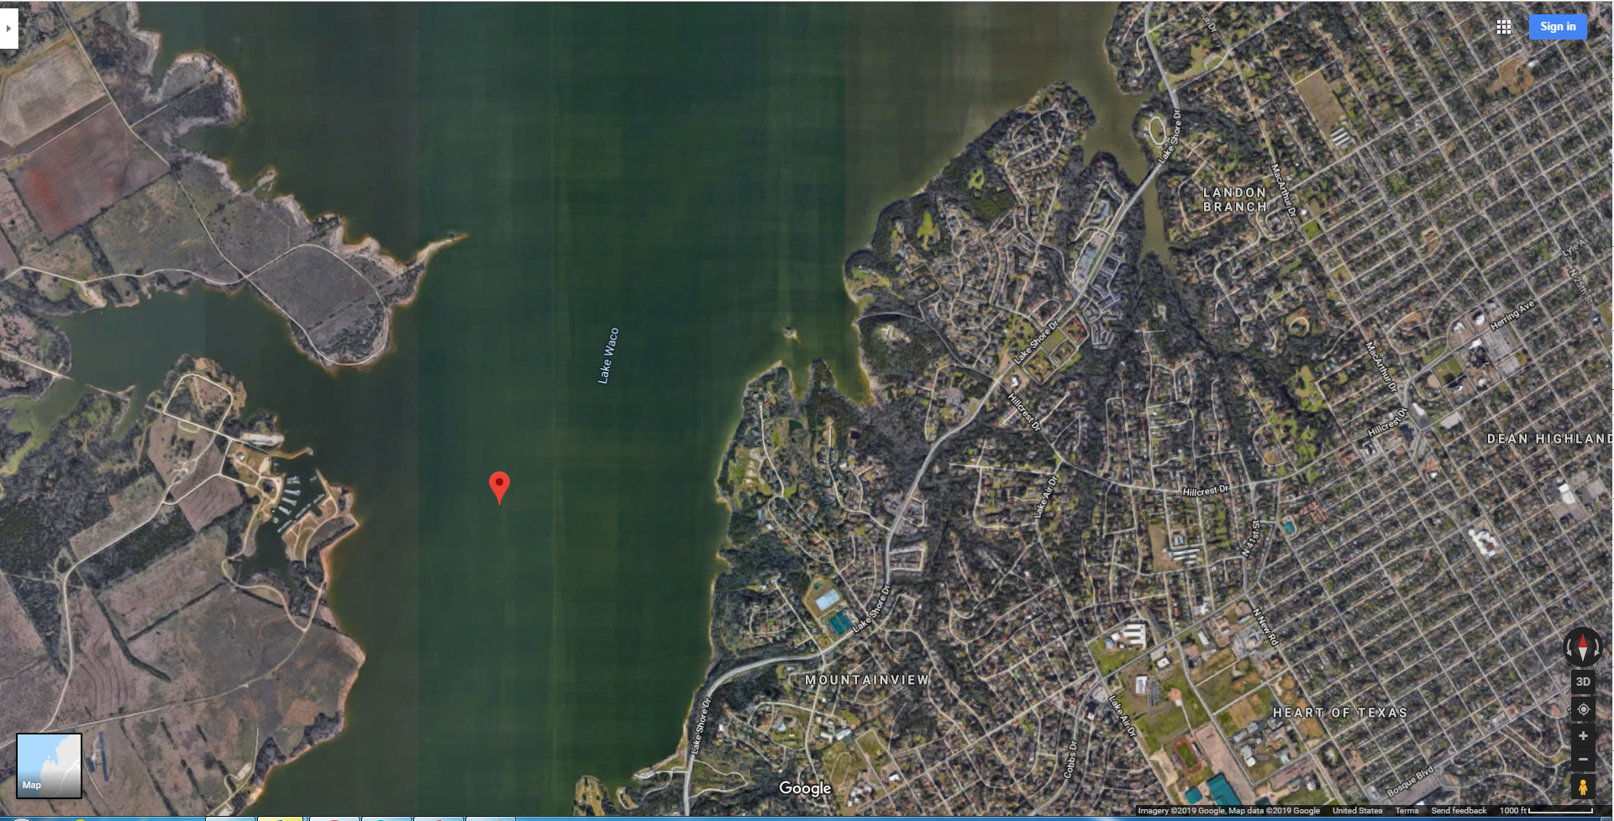
Private Residence, Lake Waco TX

Slide 24
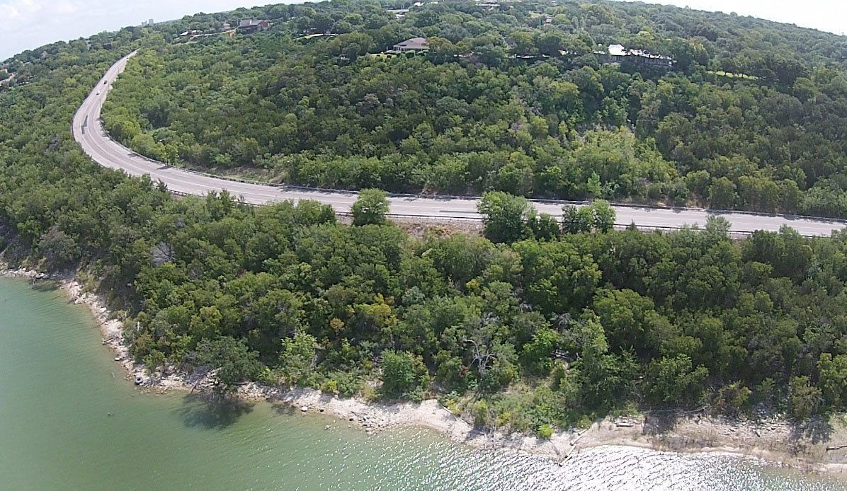
SCENIC LAKE SHORE DRIVE…

Slide 25
BASIC PROJECT INFO
Project: POTENTIAL SLOPE FAILURE
PROJECT DURATION: 60 DAYS
CONTRACT: $15,000
+++++++
AS PERFORMED:
270 DAYS
CONTRACT: $15,000

Slide 26
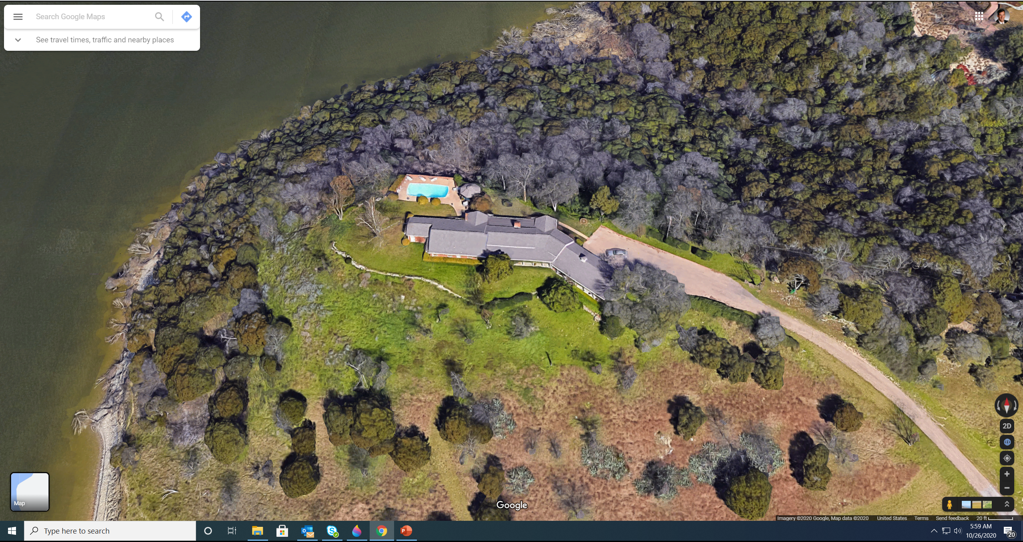
VERY SCENIC
HOUSE ON A POINT… SLOPES ON THREE SIDES…
North
West
South

Slide 27
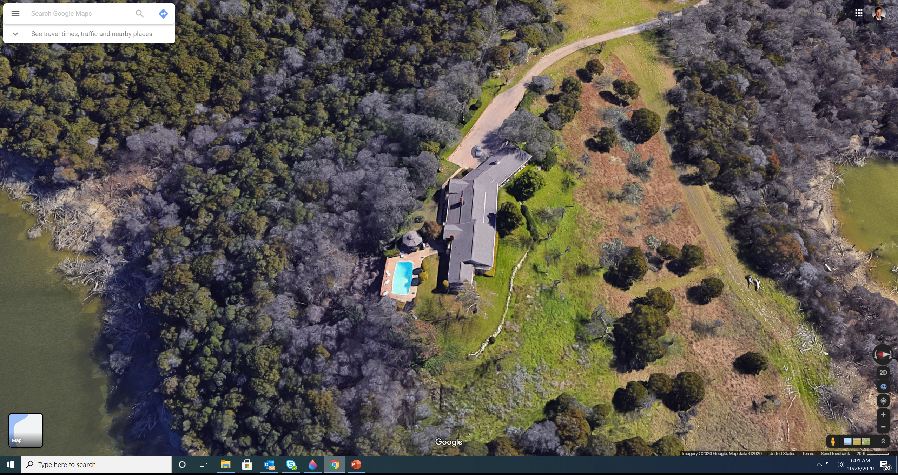
INCIPIENT SLOPE FAILURE… SOUTH AND NORTH…
North
South
West

Slide 28
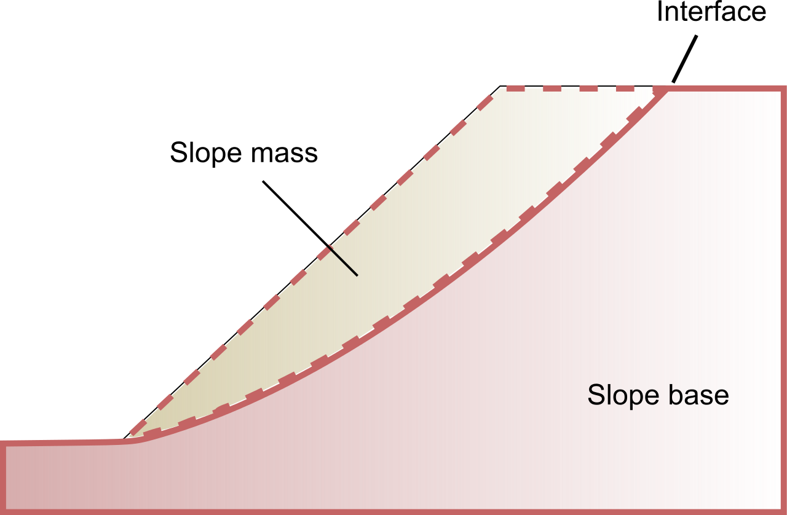
SLOPE FAILURE
SLIP SURFACE
INADEQUATE
FACTOR OF SAFTEY

Slide 29
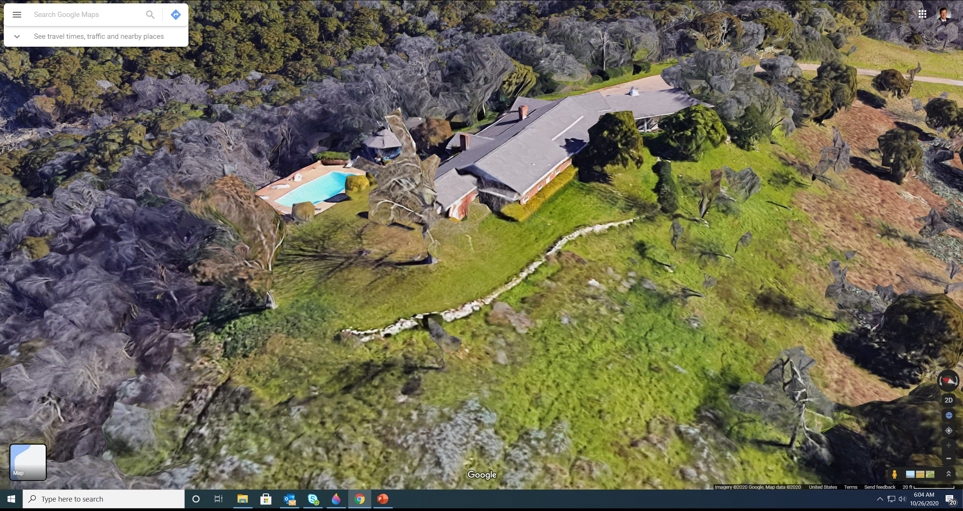
PROPOSED SOLUTION… EARTH RETENTION SOLDIER PILES

Slide 30
PROPOSED SOLUTION… EARTH RETENTION SOLDIER PILES
SOL’N:
Drilled shaft
“soldier piles”

Slide 31
THE PROJECT MANAGEMENT PROBLEM
The situation
Mar… Apr… Jun… Aug… Dec…
What do YOU think happened?
Here’s what happened

Slide 32
LESSONS LEARNED
Project management failures can… innocently happen
A project manager must know the status (budget, schedule) of his/her project at all times
The client must know, too
No matter how painful, the project manager must communicate with his/her client (and boss), both the good news and the bad news
There are no awards for submitting a project 6 months late
This type of failure is emotionally debilitating
A solid client relationship can help overcome disaster
Beware of the unpredictability of major changes to a project

Slide 33
SUMMARY
A project is a temporary endeavor undertaken to produce a unique product or service
It is common for business activities to be “project based”
Projects can go well or they can go poorly
The triple constraints on any project are scope, cost and time… assumes acceptable quality
Project management is the application of skills, knowledge, tools and techniques to project activities to meet the project requirements

Slide 34
THANK YOU.

